Slide 1

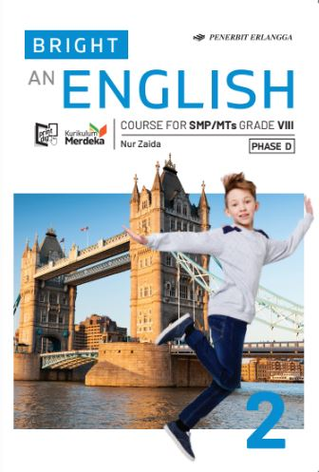
MEDIA MENGAJAR
BRIGHT AN ENGLISH
FOR SMP/MTs GRADE VIII

Slide 2
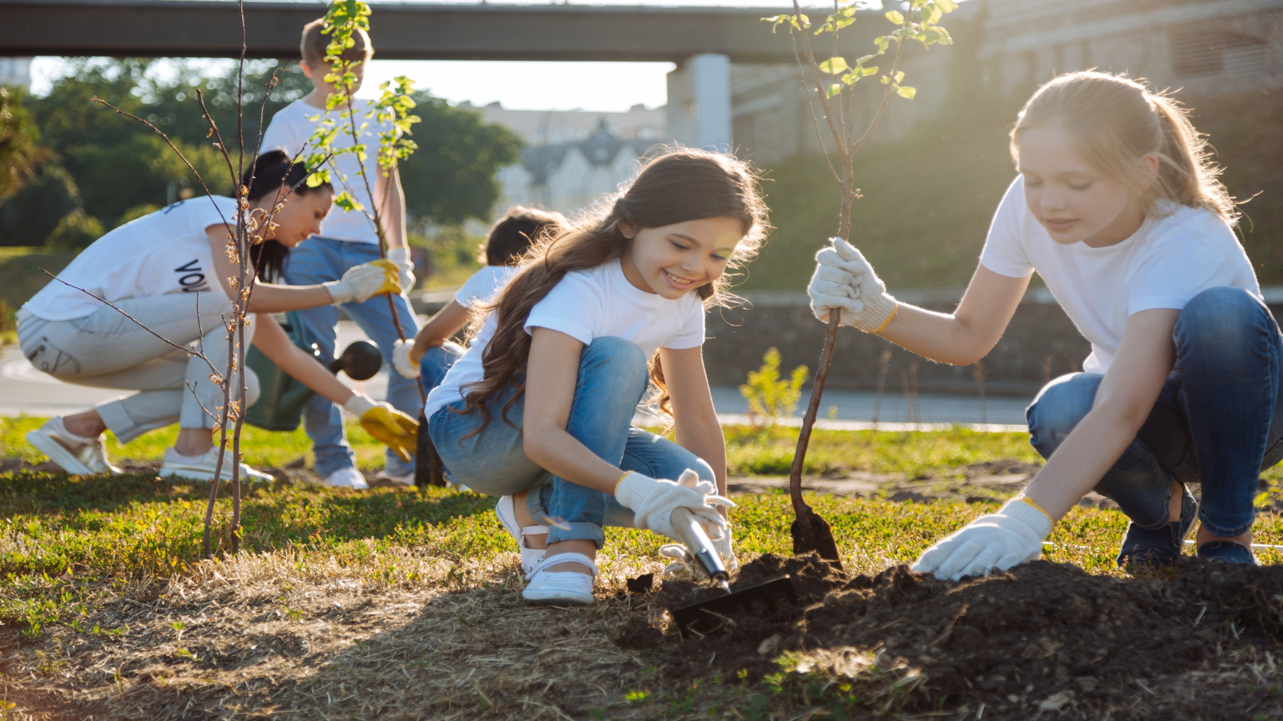
Chapter 2
What are You Doing?
Notes:
Jika terdapat gambar cantumkan sumber gambar dgn ukuran font 10pt

Slide 3
A. ……….
In this chapter, we will learn to:
describe an event that is happening at present;
identify and use the present continuous tense;
read and respond to text relating to events that is happening at present;
comprehend main ideas and relevant details in a text;
communicate ideas and experiences through simple and organised paragraphs.

Slide 4


The Present Continuous Tense
We use present continuous tense to describe something happening at present.

Slide 5
Study the following sentence
1. The students are playing basketball now.
2. The gardener is sweeping the yard right now.
3. Look! The boy is drawing a big ship in his drawing book.
4. Listen! Someone is singing.
5. Is she taking a bath now?

Slide 6
The Patterns
Giving Information
1 2 3 | She The boy The children | is is are | studying. watching Playing | TV. football.
Denying
1 2 3 | She The boy The children | is is are | not not not | studying. watching Playing | TV. football.

Slide 7
The Patterns
Asking for Information (Yes/No Questions)
1 2 3 | is is are | She The boy The children | studying. watching Playing | TV. football. | ?
The time signals include at present, now, right now, look, and listen.

Slide 8
Pronouns
We use pronouns to change the name of people or things.

Slide 9
How do you use pronouns in your sentences?
People
Subject Object | I me | we us | you you
People
Subject Object | I me | we us

Slide 10
How do you use pronouns in your sentences?
Subject |  |  | Object
I we you he she they | I know Salma. We know Salma. You know Salma. He knows Salma. She knows Salma. They know Salma. | Salma knows me. Salma knows us. Salma knows you. Salma knows him. Salma knows her. Salma knows them. | me us you him her them

Slide 11
How do you use pronouns in your sentences?
• I don’t want this painting. You can have it.
• I never watch horror films. I don’t like them.
Object pronouns follow:
1. Verb
Example:
• Dick and Jim are naughty. People hate them very much.
2. Preposition (to, for, about, on, etc.)
Example:
• She gives some money to me.
• The parcel is for you.

Slide 12
GOOD JOB!

